Slide 1
Microsoft Business Framework
Lars Hammer, Jesper Theil Hansen & Michael Nielsen
Microsoft Business Framework, Copenhagen
Tools & Server Division
mnielse@microsoft.com, jhans@microsoft.com
, lhammer@microsoft.com

Slide 2
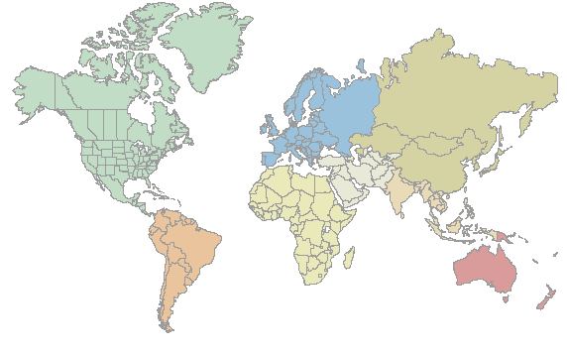
Who are we?
Visual Studio Copenhagen:
Microsoft Business Framework
  Tools
  Metadata Services
  Business Client
  Patterns
  Performance
  System Admin
Visual Studio Redmond:
C++, C#, J#, VB
IDE
Microsoft Business Framework
VSIP
Life cycle management
Notes:
What we are doing in the Green team in Vedbæk is to focus on the SCM aspects of Green and how we should build this using MBF in order to support the requirements we know exist among ISV´s, Partners and customers. We need to create a solution much more suited for easy customization of business processes in order to really fit the customers’ needs with a low TCO. We are also dedicated to ensuring a quality User Experience aligned with Longhorn, and we are presenting the first shot of the Green strategy for BillG on October 8th together with a walk-through of the architecture.
Seen from my point of view we have a unique position in Vedbæk to realize the synergies between the SCM domain, the Green Project as well as the business framework to achieve the best for our customers and partners. We can certainly leverage the fact that we are placed in Europe and know all of the issues you are faced with creating a single product that supports a multitude of different languages, legislation, business practices and cultural differences.
On the framework side we have always benefited from having the app team next door as well as being close to the European partners and customers. It has enabled us to capture support for localization and local functionality in the framework and thereby relieving the app team from rewriting the same functionality again and again.
In 1997 Navision decided to look at Microsoft to provide us with the foundation for our product and tools and I went to Redmond to meet with Bill Vaughn and the Visual Studio team in building two. We started a long relationship with Visual Studio and over the years we expanded our relationship to Office and Windows with the focus on extending Microsoft technology and not trying to build it on our own.
After Navision was acquired this lead to a decision to form an MBF team in Copenhagen with focus on tools and app support. Today the team is working in four areas:
Tools: We build prescriptive development environment tailored to ensure high developer productivity and maximize the benefit from using the Business Framework and Visual Studio.
Business Client : We will add a Business application, UI tools and programming model to MBF, extending the model driven design architecture of MBF to allow domain application developers to build breakthrough end user UI for Longhorn, Windows and Web.
Business Class Libraries: By understanding both the underlying platform and the application built on top of it and we use that knowledge to factor out general business application patterns for reuse across the application and across ISVs. This has the potential of creating a large third party community building reusable business components like ActiveX did for Office, Windows and Visual Studio
Conversion framework : Currently working on a framework and accompanying tool for converting Axapta business logic – and later we hope to be able to productize the framework in order to help MBS and ISV’s to convert the business logic and data from their legacy product.
In order to speed up integration with the other MBF sites and other Microsoft teams we have taken a number of initiatives:
We now have people from Copenhagen working in Fargo, Findlay and Redmond on three to six months contracts.
We have moved a senior developer from Redmond to Copenhagen and another from Copenhagen to Redmond
We created a five person MBF Copenhagen team in Redmond lead by an Office veteran who has been with Microsoft for 12 years focusing on Office and Longhorn integration
We have created a strong network among the PM’s, Devs and Testers across the four MBF sites

Slide 3







Historically ISV’s and Enterprises have developed proprietary frameworks & tools to meet there needs
Axapta
Enterprises
Domain
Biz Logic
Domain
Biz Logic
Domain
Biz Logic
Domain
Biz Logic
Domain
Biz Logic
Business
Logic
Common
Biz Logic
Common
Biz Logic
Common
Biz Logic
Common
Biz Logic
Common
Biz Logic
Proprietary
Frameworks & Tools
Proprietary
Application
Framework: “Dexterity”
Proprietary
Application
Framework:
“VB Tools..”
Proprietary
Application
Framework:
“C/SIDE”
Proprietary
Application
Framework:
“MorphX”
Proprietary
Application
Framework
SQL Server
SQL Server
SQL Server
SQL Server
SQL Server
Windows
Platform
Windows
Windows
Windows
Windows
Windows

Slide 4

Typical components of such proprietary frameworks and tools
Proprietary
Framework
Proprietary
Tools
Presentation
Reporting
System Admin
Report Designer
Binding
Business Logic
Integration
Form Designer
Proprietary
Application
Frameworks
Workflow
Customization
Scheduling
IDE
Data Access
Eventing
Security
Data Dictionary
Windows platform

Slide 5
What’s the ISV’s Pain?
Business applications are difficult to build
Require multiple skills to build
Face continuous & rapid technology evolution
+
Have a complicated value chain
+
Need large and generic, run-time capabilities
+
Are adopting distributed internet architectures
+
Large, Complex, Difficult to Develop and Maintain

Slide 6
Multiple Technical Skills to Build
Leaves less time to focus on the domain
OO / UML / OO programming for the domain
Transact SQL / SQL Server for persistence
MDX / Analytics Server for OLAP
XLang/X / BizTalk Server for Orchestration
WinForms / Avalon for the rich client
HTML / ASP.NET for thin or semi-rich client
ASP WebParts / WSS & SPS for portals
XML, SOAP / Indigo & Whitehorse for WS
Each has its own set of abstractions!

Slide 7



Rapid Technology Evolution
Harder to transition now than ever before.
Web / SOA Paradigm
XML Enabled
Disconnected
Interconnected
Message Based
Web Service Enabled
Scalable
Distributable
Aggregated User XP
Composeable User
Web Based
Multiple Device Targets
Broader Reach
Work Flow Enabled
Inter Organization
Distributable Security
Meta Data Driven
Event Based
Interapp Communication
across the internet
Technology is changing rapidly
Many vendors failed to make the transition to Client / Server
Current transition to Web / Distributed Internet / SOA is orders of magnitude more difficult than DOS to Client / Server
Microsoft must enable more organizations to make the transition
Difficulty of Making Transition
Client/Server Paradigm
Event Based
Graphical UI
Random Access
Interapp communication
on same machine
DOS
Character Based
Single application
Notes:
The number of Great Plains’ competitors dropped precipitously when going to GUI client / server.

Slide 8
Complicated Value Chain
Customize, extend, and upgrade essential.
Middle Market customers buy from channels and may extend the solution themselves
Enterprise
Customer
Middle
Market
Customer
Small Business
Customer
Reselling
ISV
“Tier 2” ISV’s integrate, extend or OEM another ISV’s solution
Selling and Implementation Partner
Small Business customers buy either through VAR or retail
Enterprise customers buy direct and build applications for internal use
“Tier 2” ISV
n
-
Way
VARs implement solutions and do simple app development
Reselling
ISV
Retail
Integration/OEM
Extension
IT
Development
“Tier 1” ISV
ISVs develop business applications and may sell and implement direct or through a channel
Microsoft Business Framework

Slide 9
Generic, Run-Time Pieces
Expected, necessary, but not domain-specific.
Business applications integrate these large pieces with their domain-specific parts:
  Reporting and analytics
  Workflow
  Portal
  Security
  Deployment & Administration
  Customization ‘IDEs’
Hard to
  Build from scratch
  Integrate when provided by a partner

Slide 10







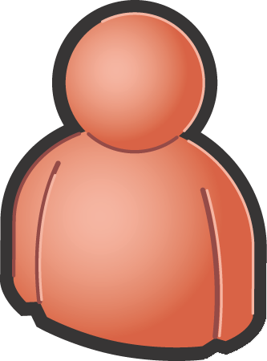
Distributed Internet Arch.
New, complicated, and necessary.
The business application must integrate with web services to enhance the end-user experience.
Service-Oriented Architecture and the web services on which it is based require skills in distributed computing and message management.

Slide 11
Business applications are complex
Customers and partners need to understand and change them
Business Applications are large
  Traditional Business applications have thousands of forms and tables
    Example: Great Plains has 1000+ forms, 600+ tables, Millions of LOC
Business Applications are FULL of patterns
  One ISV partner defines seven types of forms, every form in the system (500+) fits the pattern
  Business Logic follows patterns
    Defaulting, Validation, Calculated Values
  Business Logic tends to be symmetric. (A purchase order is somebody else’s sales order)
Business Applications need to support “Micro verticals”
  ISV produces “retail”, ISV customizes for “apparel”, Partner customizes for unique commission algorithm.
Business Applications need to support complex upgrade \ versioning scenarios
  Business applications tend to be very difficult to upgrade
  Upgrades very costly to the customer

Slide 12
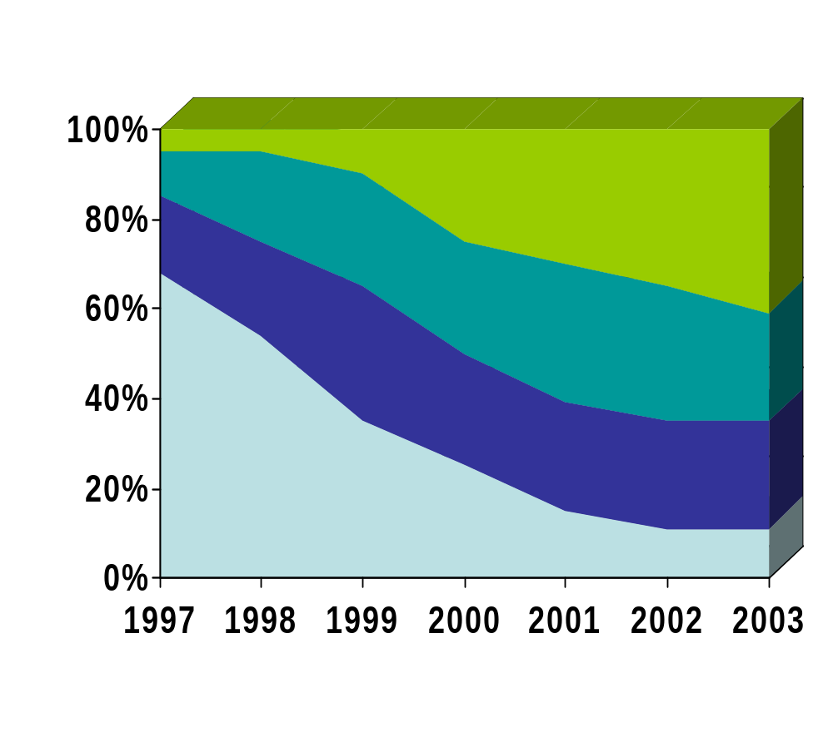
Customers are asking for more
Driven by Demand for Vertical Solutions
Vertical
Custom
Bolt-on
Core ERP
Source: Gartner Research; Core ERP includes Accounting, Purchasing, Order Management, Costing, Inventory Management, Production Management; Bolt-on includes CRM and SCM

Slide 13

MBF Value Proposition
MBF customer focuses on end user needs
Unrealized Customer Needs
Functionality
Gap Solved by
Customization
ISV Vertical,
Industry &
Horizontal
Functionality
Higher Solution Value
to customers!
ISV Vertical Functionality
ISV Industry Functionality
ISV Horizontal Functionality
Proprietary
Middleware
Microsoft Business
Framework
Microsoft Servers and Tools

Slide 14
The MBF Messages
What MBF is
The Microsoft Business Framework extends the Windows platform allowing customers to replace their proprietary business frameworks and tools and focus on developing the highest-value applications for their customers.
The
Promise
The Microsoft Business Framework provides a prescriptive model driven architecture plus a set of model driven tools and runtime application services for constructing complex, extensible, and upgrade-safe business applications on .Net.
The Technology
Notes:
Possible Tagline –
Seamless computing for Business Applications
Product Line Messaging – “The How”:
The Microsoft Business Framework provides programming abstractions and a prescriptive meta-data driven architecture suitable for the development and deployment of business applications based on a distributed, service oriented architecture. The framework insulates business logic written to these abstractions from changes to underlying technologies, preserving the critical asset of a business application development team. MBF extends traditional approaches to model-driven development, moving from a design-time model with code generation to having true “model aware application services” which can interpret the model at runtime. (product-line message)

Slide 15
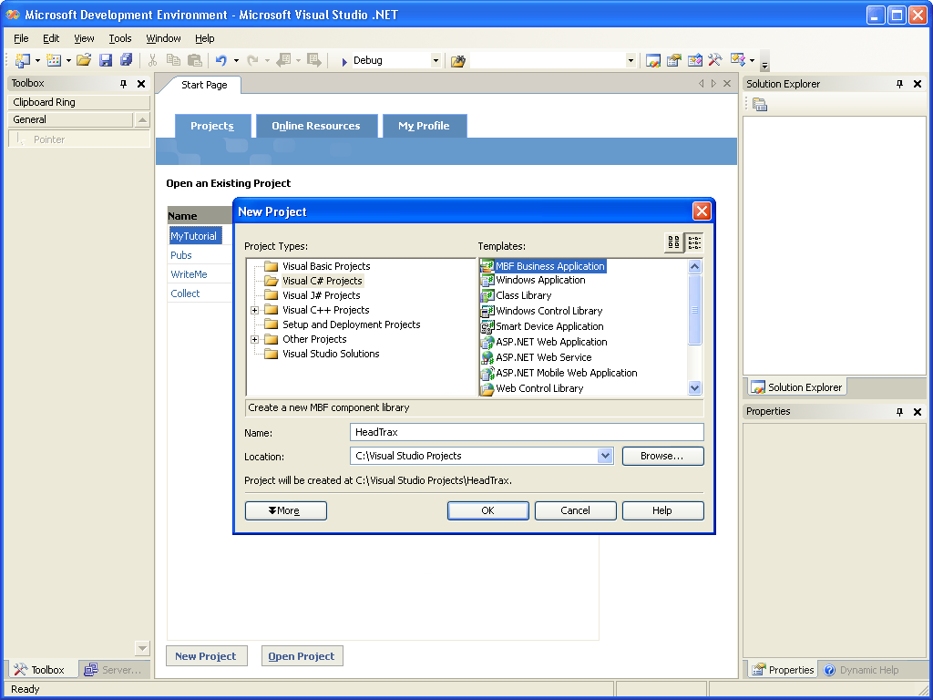
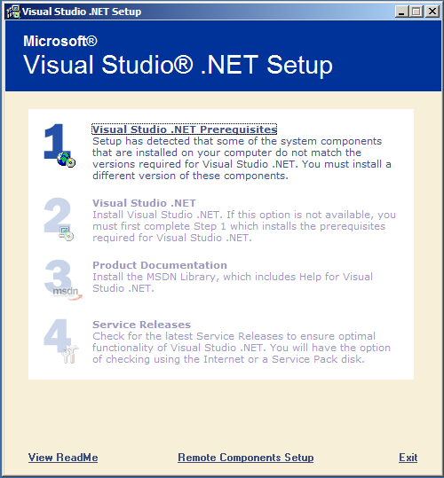
MBF is part of Visual Studio
MBF will ship in the Enterprise VS.NET SKUs.
MBF is standard part of any Enterprise SKU install.
You can start a new MBF project.

Slide 16
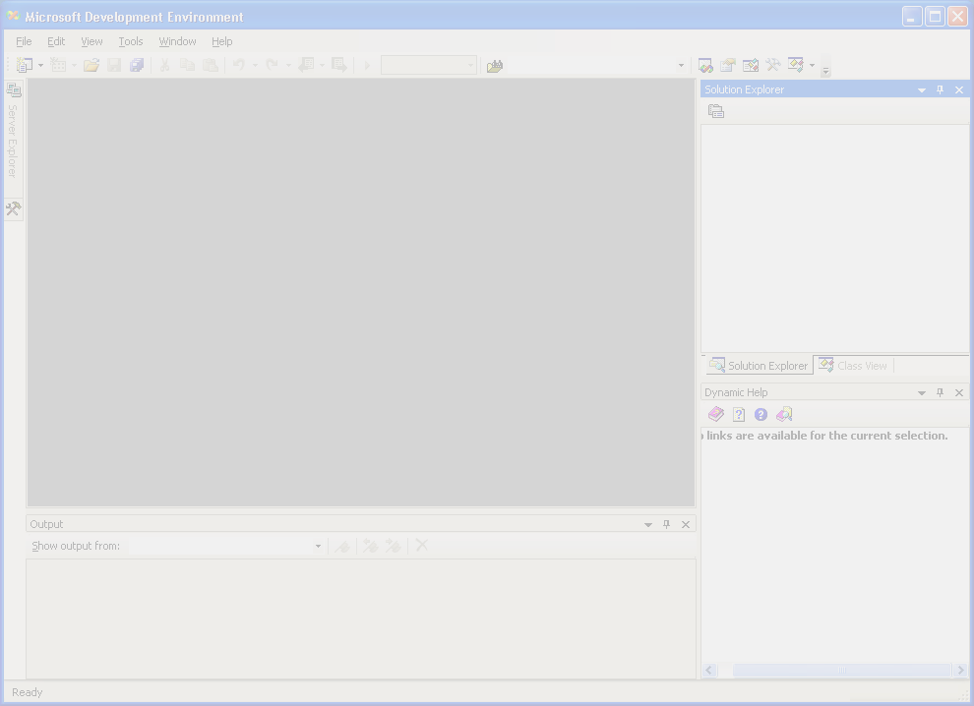
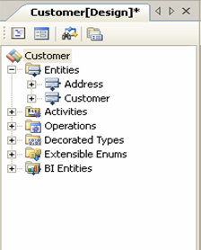
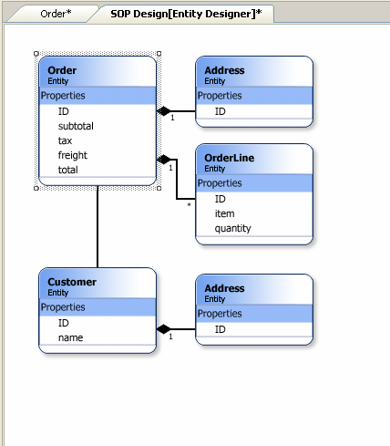
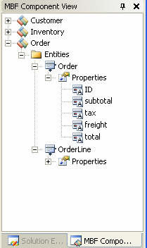
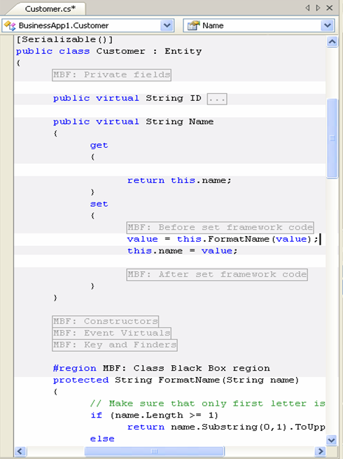
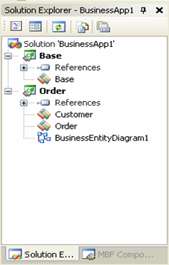
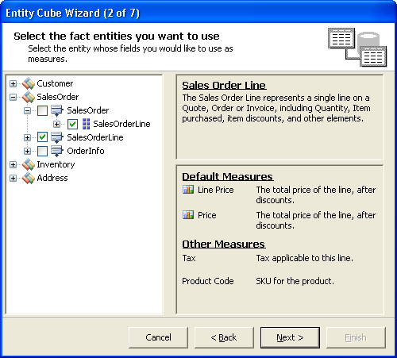
Model driven development
Model

Slide 17
Key Abstraction Concepts
Entities, Operations & Libraries.
Entities
Represent “smart data”
  Defaulting
  Validation
  Calculated Values
Contain no database logic
  Persisted through an O/R layer
Identified by a “Key”
Have noun names
  Customer, Vendor, Order
Operations
Contain business logic
  Transactable
  Extensible by ISVs
Contain no database logic
  Persist results via Entities
Have verb names
  PostInvoice, GetNextNumber…
Entity
(Smart
Data)
Operation
(Business
Logic)
Libraries
Groups entities, operations and such
  Any types that manage a biz abstraction
  Spans domains, more than a CLR assembly
Have noun names
  Orders, Pricing, IVLedger

Slide 18
Agent / Service
Providing SOA with a rich emissary.
Agent
  Primary interface to consumer
  Contains state between calls
  Lives on the “workspace tier”
  Is remotable (marshall by value)
Service
  Is stateless between calls
  Lives on the “enterprise tier”
  Can define transactional boundaries
Agents
Services
Entity
(Smart
Data)
Operation
(Business
Logic)

Slide 19
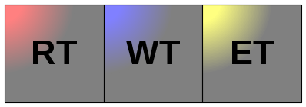

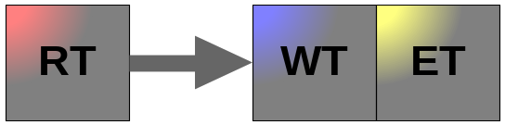
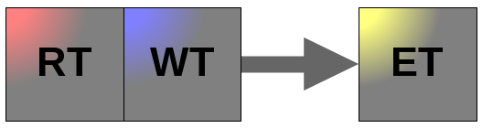
Agent/Service & Deployment
Logical tiers can be flexibly deployed.
Single Machine
Rendering Tier – UI tier
  For thin client, this is the browser
  For rich client, WinForms
Workspace Tier
  Agents reside on this tier
  For thin client, this is also the web server
Enterprise Tier
  All services run on this tier – stateless business logic
Database Tier
  Persist enterprise data
  SQL Server
DB
Fat Client
DB
Thin Client
DB
Rich Client
DB

Slide 20
Key Surrounding Services
Support the MBF abstractions.
Task Security controls access to behavior
Basic .NET Code Access Security, with extensions to handle more complex role \ org structure scenarios
Dynamic View controls access to data
Row-level filtering
CRUD authorization
Agents
Task Security
Dynamic View
Services
Entity
(Smart
Data)
Operation
(Business
Logic)
Reliable Execution
Reliability via restart
Consumer cannot expect a synchronous call
Replaced by ‘Windows technology in next release

Slide 21

Activities and Entity Cubes
Build upon the core abstractions.
Agents
Task Security
Dynamic View
OLAP Consumer
Services
Process
Consumer
Entity
(Smart
Data)
Operation
(Business
Logic)
Reliable Execution
<Uses>
<Uses>
EntityCubes
Operations
Activities
EntityCube
EntityCube
Entity
Entity
EntityCube
<Uses>
EntityCube
EntityCube
Entity
Entity

